Slide 1

GOLD PRICE PREDICTION PROJECT
Sanket Dholi
Krishna Biju
Kshitija . S. Jadhav
Chandana Sonti
Prajyot B. Kulkarni
Mahesh Rathod
Nikhil Karnur

Slide 2
AIM OF THIS PROJECT
The main aim of this project is to predict the rate of the gold at earlier stage using machine forecasting.

Slide 3
ABSTRACT
The demand for gold never ends. The gold rate tend shows that gold is one of the best investment plans. So it is wise to predict the trend of the gold rate. Different statistical models can be used for suitable modeling and prediction of data. This project summarizes the idea of gold rate prediction using the forecasting.

Slide 4
TIMELINE OF THE PROJECT
We took 3 types of datasets and studied them thoroughly. Later we have done visualization part. Later from that datasets we have chosen one dataset and went to the EDA part. Next we are done with model building, model evolution, prediction, forecasting then finally with deployment.

Slide 5
PROJECT ARCITECTURE
Dataset Collection
Data cleaning
EDA
Model Building
Model Evolution
Prediction
Forecasting
Deployment

Slide 6
DATASET COLLECTION AND CLEANING
2182 rows and 2 columns
Year range 01-01-2016 to 21-12-2021
Unique Date 2182 Price 1876
Datatypes :
Date = Object
Price = Float64

Slide 7
EDA
Exploratory Data Analysis (EDA) .
1. Initial Data Visualization
We started by visualizing the entire dataset to get a general understanding of the data’s characteristics.
2. Data Resampling
The data was resampled on a yearly basis, and further visualizations were performed to identify trends and patterns specific to each year from 2016 to 2021.
3. Outlier Detection & Treatment
We employed various methods for outlier detection. Detected outliers were treated using the backward fill method.
4. Data Smoothing
To handle the outliers in the entire dataset, we applied a data smoothing technique. This helped in reducing the noise and revealing more clear patterns in the data.
5. Dickey-Fuller Test - Round 1
We performed the Dickey-Fuller test to check the stationarity of the data. The initial p-value was 0.95, indicating that the data was non-stationary.
6. ACF and PACF
To make the data stationary, we applied AutoCorrelation Function (ACF) and Partial AutoCorrelation Function (PACF) techniques.
7. Dickey-Fuller Test - Round 2
We performed the Dickey-Fuller test again. This time, the p-value was 0.000, indicating that our data had become stationary.
Exploratory Data Analysis (EDA) is a method used to study and explore datasets to understand their main characteristics, discover patterns, locate outliers and identify relationships between variables. EDA is usually carried out as a preliminary step before undertaking more formal statistical analyses or modeling

Slide 8
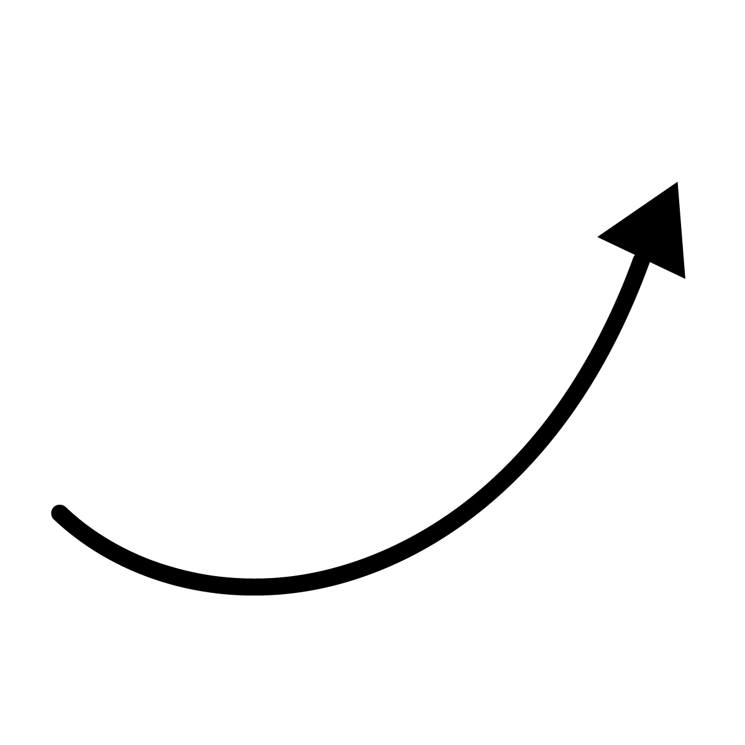
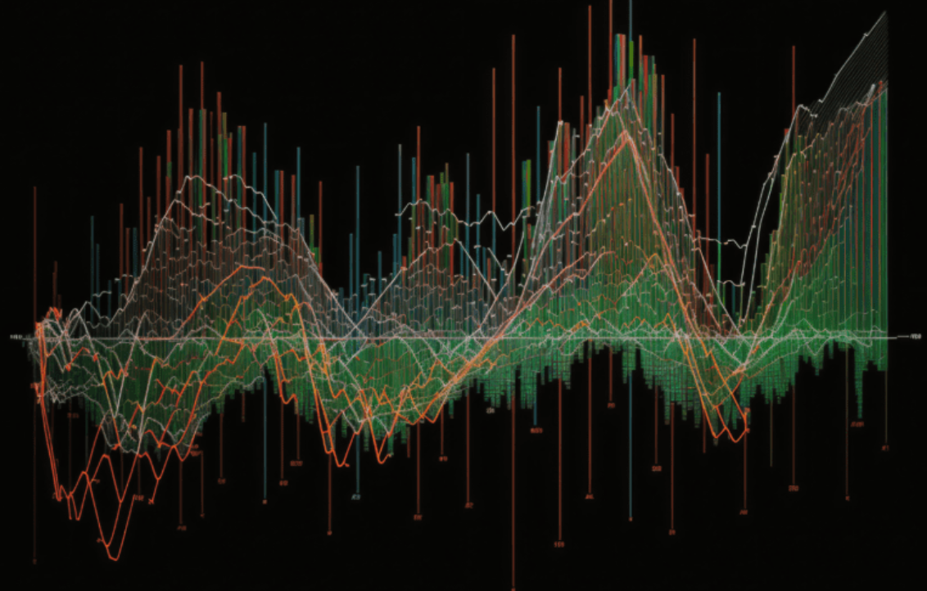




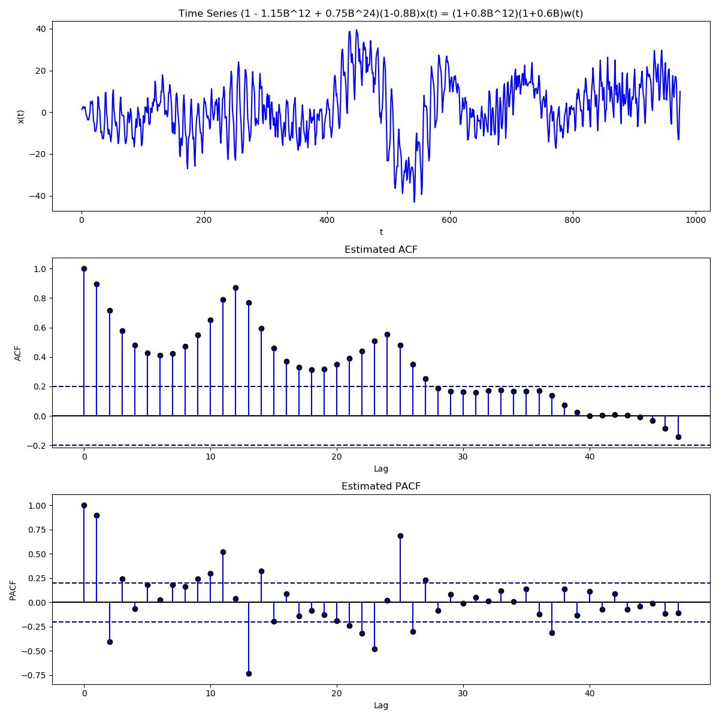
EDA
Data Smoothing
Outlier Detection & Treatment
Data Visualization
Data Resampling
Dickey-Fuller Test(ADF)
ACF and PACF

Slide 9
Model building: Model building involves choosing an appropriate algorithm or modeling technique that is suitable for the specific problem and dataset. The choice of the model depends on various factors such as the type of task (classification, regression, clustering, etc.), the nature of the data, the size of the dataset, and the desired interpretability or accuracy of the model.
SARIMAX
SARIMAX(Seasonal Auto-Regressive Integrated Moving Average with eXogenous factors) is an updated version of the ARIMA model. ARIMA includes an autoregressive integrated moving average, while SARIMAX includes seasonal effects and eXogenous factors with the autoregressive and moving average component in the model. Therefore, we can say SARIMAX is a seasonal equivalent model like SARIMA and Auto ARIMA.
The "p," "d," and "q" values refer to the orders of the autoregressive (AR), integrated (I), and moving average (MA) components, respectively. These values help determine the structure and behavior of the model.
Here's a brief explanation of each parameter:
p (AR order): The autoregressive order (p) represents the number of lagged observations of the dependent variable (y) that are included in the model. It captures the linear relationship between the current observation and its previous values. For example, if p = 2, the model will consider the two most recent lagged values of y.
d (I order): The integrated order (d) refers to the number of times the raw observations of y are differenced to make them stationary. Differencing is a common technique used to remove trends and seasonality from the data. If d = 1, the model uses first-order differencing; if d = 2, it uses second-order differencing, and so on.
q (MA order): The moving average order (q) represents the number of lagged forecast errors of y that are included in the model. It captures the unexplained shocks or random fluctuations in the data. For example, if q = 1, the model will consider the most recent lagged forecast error.

Slide 10
Data fit: Data fit refers to how well a model matches or fits the observed data. In the context of a SARIMAX model, data fit is typically assessed by comparing the model's predicted values to the actual values of the target variable. A good data fit means that the model's predictions closely align with the observed data points, indicating that the model captures the underlying patterns and relationships in the data.
Data split: Data split refers to the process of dividing a dataset into two or more subsets for model training and evaluation. The most common approach is to split the data into a training set and a test set. The training set is used to fit the model, while the test set is used to assess the model's performance on unseen data. This helps evaluate how well the model generalizes to new data and avoids overfitting, which is when a model performs well on the training data but poorly on new data.
RMSE value: RMSE stands for Root Mean Squared Error, which is a commonly used metric to evaluate the accuracy of a predictive model. It measures the average magnitude of the differences between predicted values and actual values. In the context of a SARIMAX model, the RMSE value is calculated by taking the square root of the average of the squared differences between the predicted values and the actual values of the target variable. A lower RMSE indicates better predictive accuracy, as it means the model's predictions are closer to the actual values.
Calculation: RMSE is calculated by taking the square root of the average of the squared differences between the predicted values and the actual values of the target variable. The formula for RMSE is as follows:
RMSE = sqrt( (1/n) * sum( (predicted - actual)^2 ) )

Slide 11
Model Evaluation
Models | MAE | MSE | RMSE_Values | MAPE(%)
ARIMA | 83.72 | 7898.85 | 88.84 | 1.9183
SRIMA | 94.22 | 9888.62 | 99.44 | 2.1587
HOLTWINTERS | 122.27 | 16558.62 | 128.67 | 2.8013
For model evaluation we have calculated mae, mse, rmse and mape.
Here we can see that rather than arima and holtswinter, sarima model have low mae, mse, rmse and mape. So we choose sarima as the best model.

Slide 12




Accuracy and Limitations of Forecasting
Targeting Accuracy
Balancing Complexity
Data Availability
Addressing Uncertainty
The quality and availability of data can significantly impact the performance of forecasting models, necessitating careful data curation and preprocessing.
Forecasting algorithms strive to achieve high accuracy in predicting gold prices, but the inherent volatility and complexity of the market can pose challenges in reaching perfect predictions.
While more sophisticated algorithms can capture intricate relationships in the gold market, there is a delicate balance between model complexity and the interpretability of the results.
Forecasting models must be designed to handle the inherent uncertainty in the gold market, providing not just point estimates but also quantifying the associated risks and confidence intervals.

Slide 13




Applications of Gold Price Forecasting
Investment Strategies
Risk Management
Policy Decisions
Industry Planning
Governments and central banks can leverage gold price forecasting to inform their policy decisions, such as adjusting foreign exchange reserves or implementing trade policies.
Accurate gold price forecasts can help investors and portfolio managers develop more effective investment strategies, such as asset allocation, hedging, and diversification.
Forecasting models can provide valuable insights for risk management, enabling organizations to anticipate and mitigate the financial risks associated with gold price fluctuations.
Companies in the gold mining, refining, and jewelry industries can use forecasting models to optimize their operations, supply chains, and pricing strategies based on anticipated market conditions.

Slide 14


Slide 15
The problems we got while doing the model !
First, we chose a data set that was provided by Haresh Sir for a specific reason: the data is correctly formatted and free of null values.
We selected the data and proceeded to the EDA section of the eda. After seeing the outliers in the box plot, we resampled the data and attempted treating the outliers using arima, IQR, Z-score, smoothing, backfill, and forward fill.
As part of the eda, we created a decomposition plot. From that plot, we were able to observe some seasonality and trend, thus we selected the Saima model.
model building: To get the optimal pdq values for our model building, we have performed a loop for the model building.
We have large rmse values in the model construction process, so we must proceed with the model evaluation.
To improve the model's rmse and accuracy, we used the Holts Winter approach during the evaluation process.

Slide 16
We have utilized the model for forecasting.
We have utilized the model for forecasting.
We encountered several difficulties during deployment, such as formatting errors that we handled incorrectly. As a result, we successfully corrected the codes and deployed the system.
Obtaining certain gold feature values for the model

Slide 17
Thank you

